Slide 1
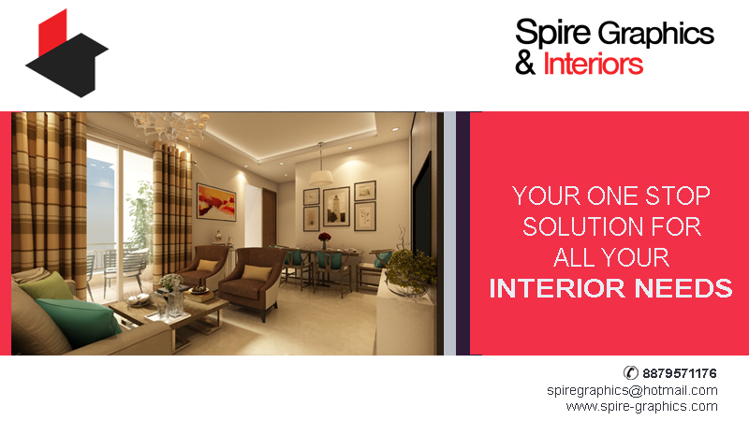
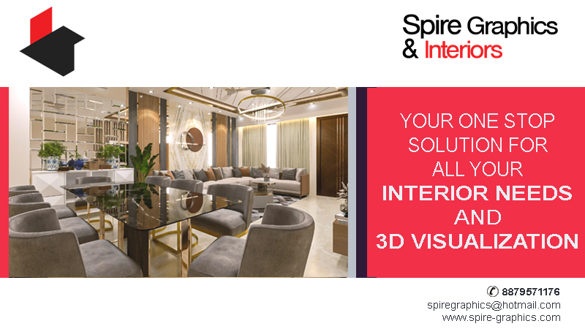
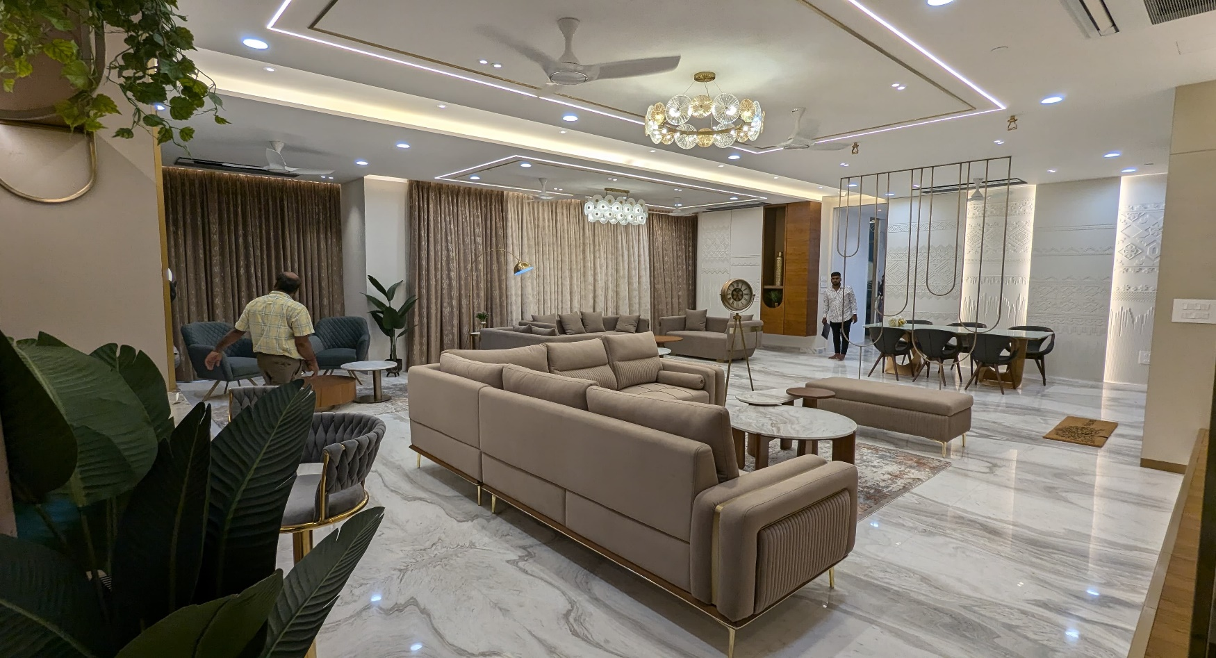
Your One - Stop Solution for all Your Interiors Needs

Slide 2

Profile
JYOTI SINHA established Spire Graphics and Interiors in 2004. She is an INTERIOR DESIGNER who specializes in providing complete Interior Design solutions including 3D Visualization.
Design is not just a career, it’s a passion and what she loves most is the variety of experiences a design career provides. She likes clean lines, classically inspired style combined with more textural objects. Her aim is to reflect the client's needs, personality and individual style into the existing interior. She also providing high standard 3D rendering services
Design means creativity and it's really important to have inspiration and beauty in your life every day.
“ I'm inspired by anything and everything in my everyday surroundings. The slightest detail can set of my imagination rolling ”

Slide 3
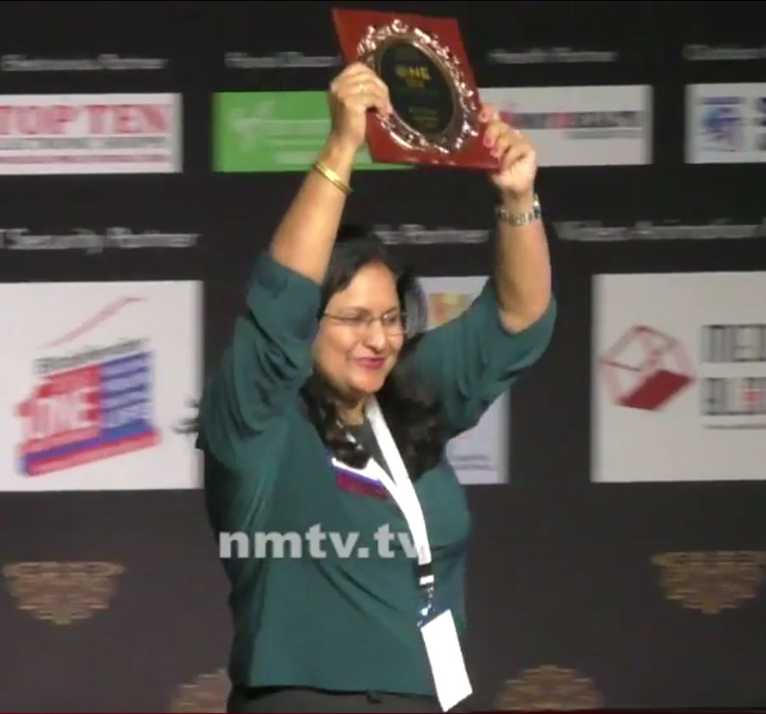
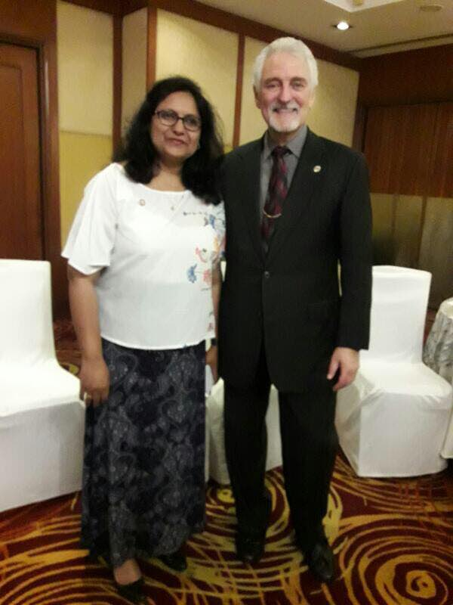
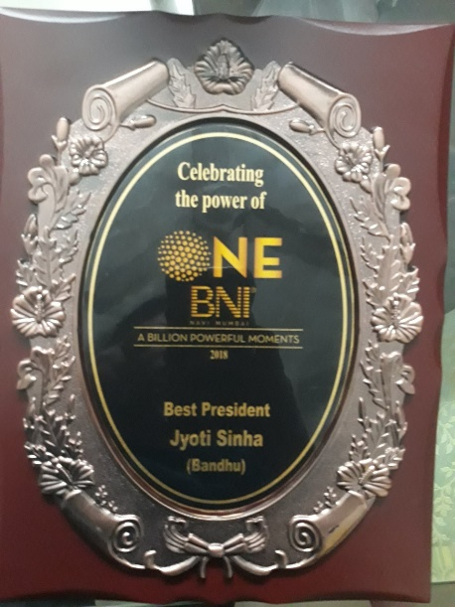
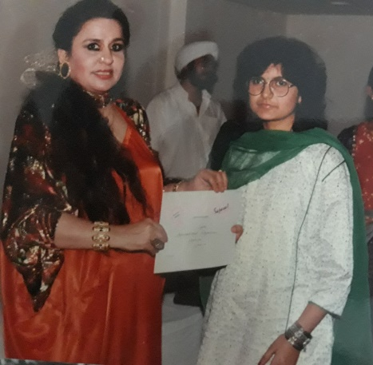
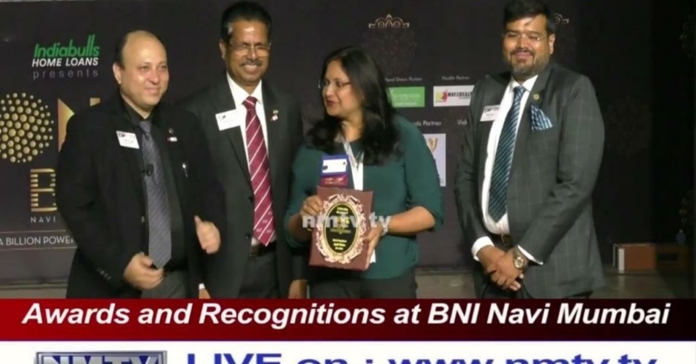
Timeline
1991- Start of the my professional journey with Sajawat Interiors, New Delhi
1995- Started my own firm ‘Aakriti Interiors‘
2004- Started Spire Graphics and Interiors in New Delhi
2012- Continued my Spire Journey in Navi Mumbai
2016 – Associated with BNI, Navi Mumbai and led the most successful chapter as the President
2017 – Associated with Mint Infotech Pvt Limited for the last 5 years
Awarded the best President award at BNI International, Navi Mumbai Chapters
With Ivan Misner, founder of BNI International,
Awarded as best interior designer at Sajawat interiors

Slide 4
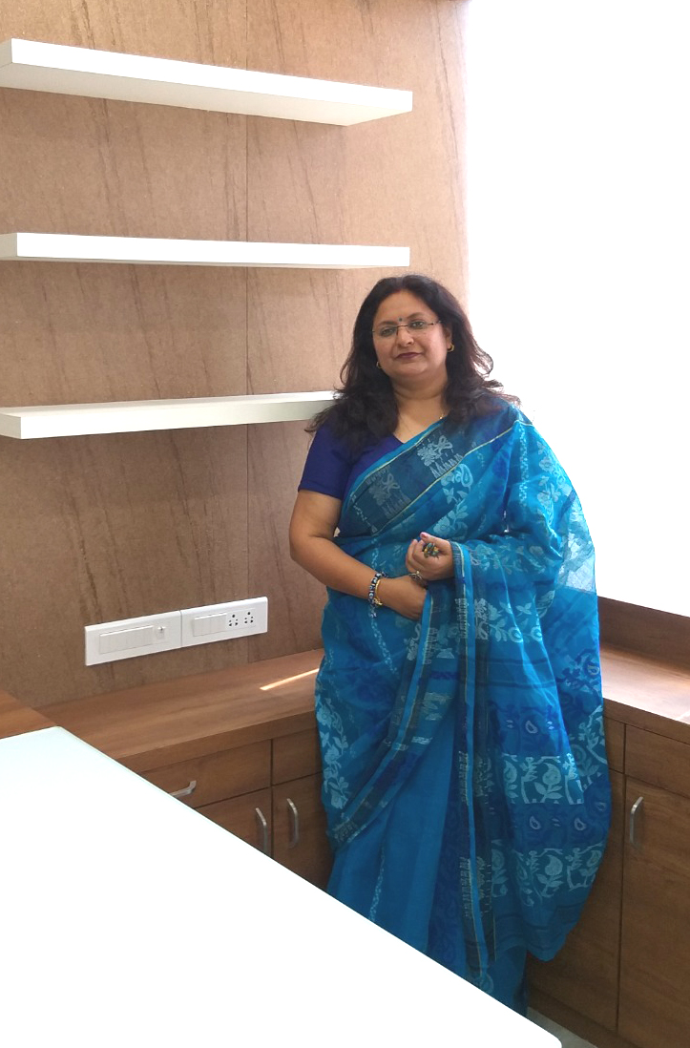
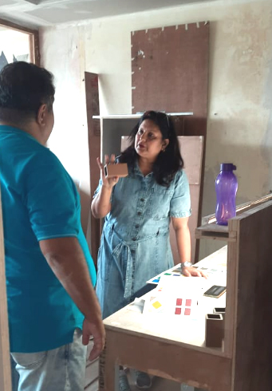
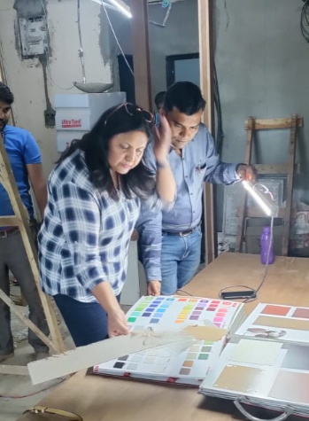
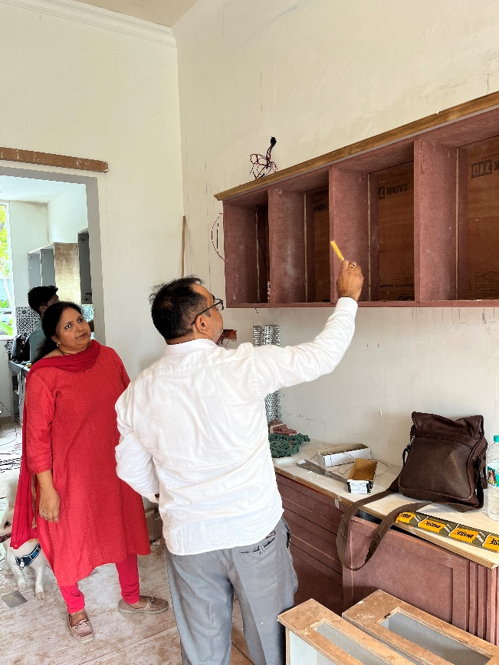
Our Mission
Our mission is to provide a personalized and cost-effective interior design solutions for Commercial and Residential spaces which are delivered on time with an unsurpassed attention to detail.

Slide 5
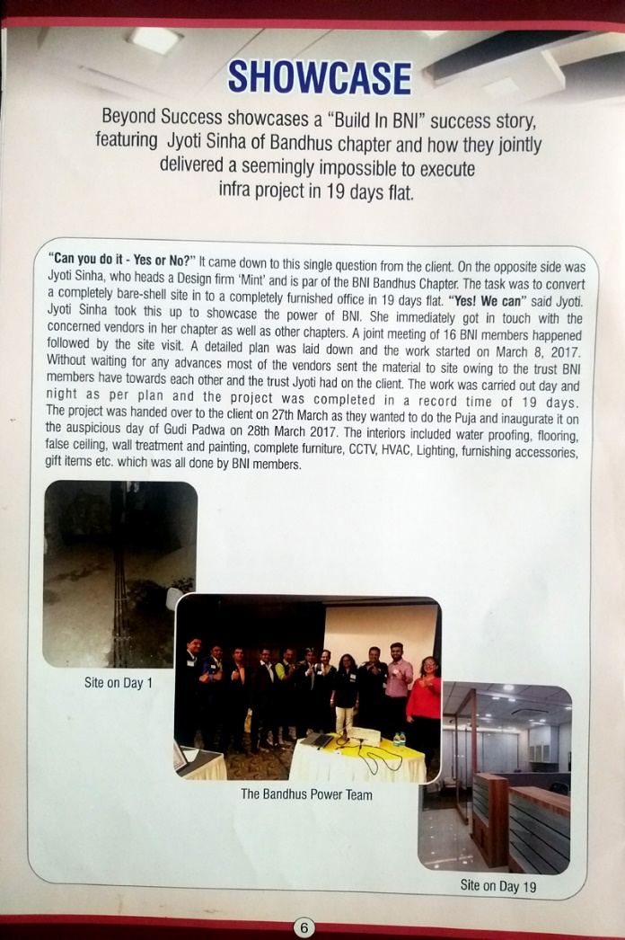
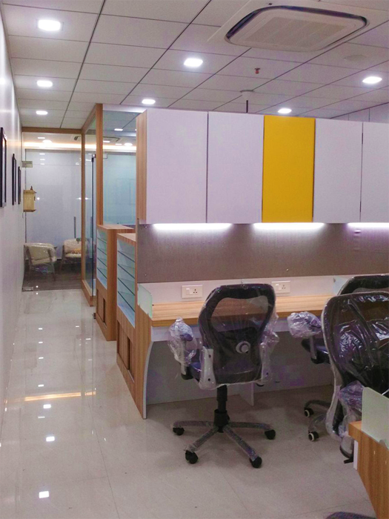
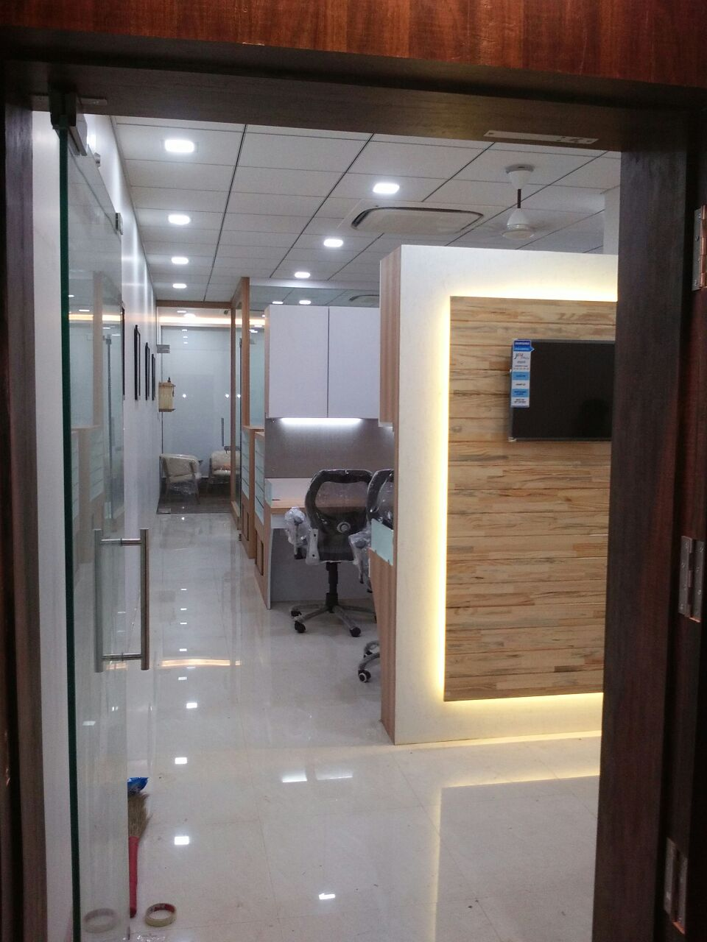
Showcase
Techno DCS office in Navi Mumbai completed in record 19 days

Slide 6
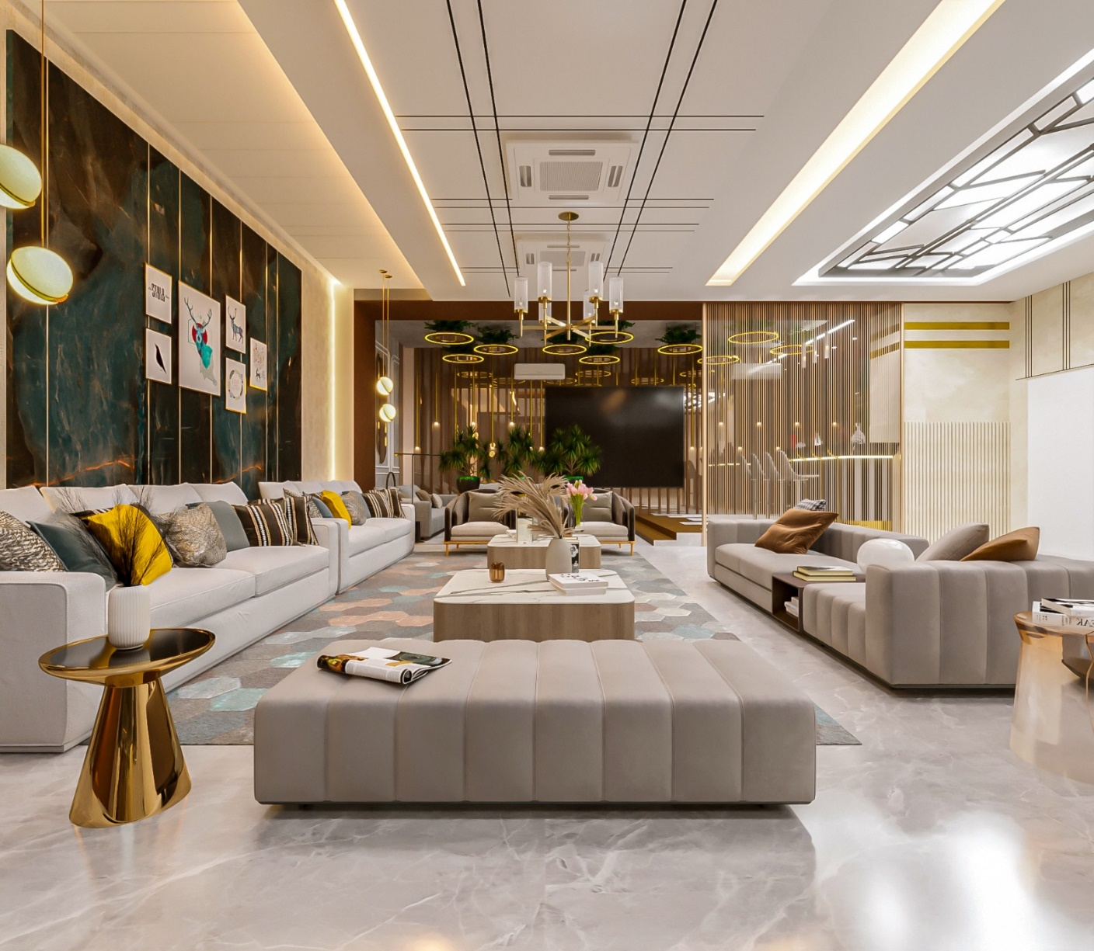
What we do - Interiors
Interior Design Consultancy
Art Wall
Turnkey Execution
3 D views presentation

Slide 7
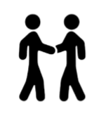
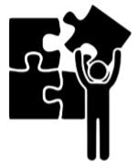
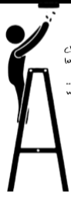
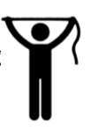
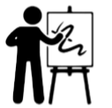
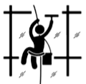

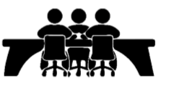
How we do
Brief from Client
Survey
Research
Mood Board
Space Plan
3D Design
Fitting Fixtures & Furniture
Accessories
Hand over

Slide 8
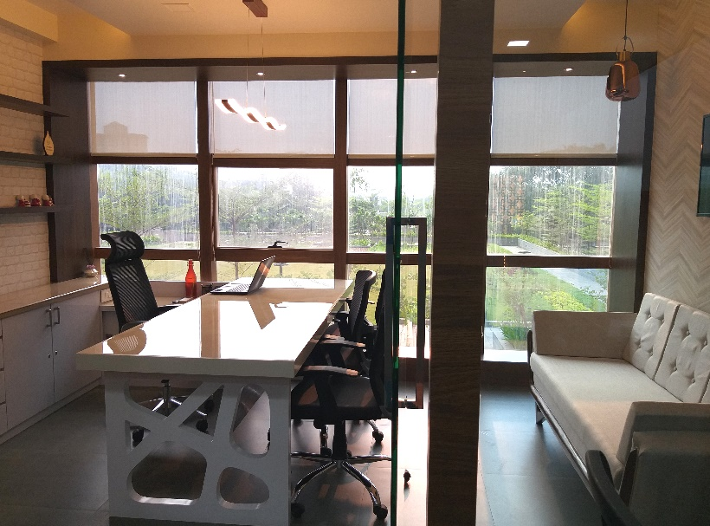
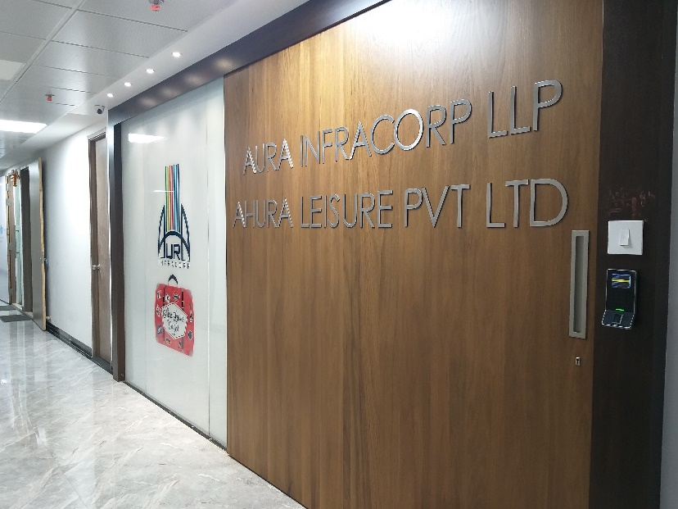
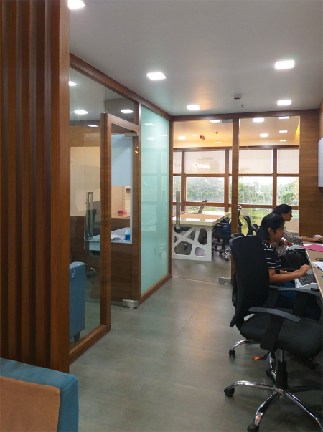
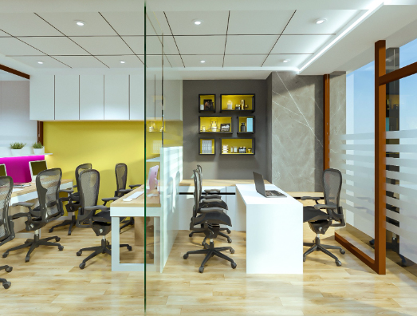
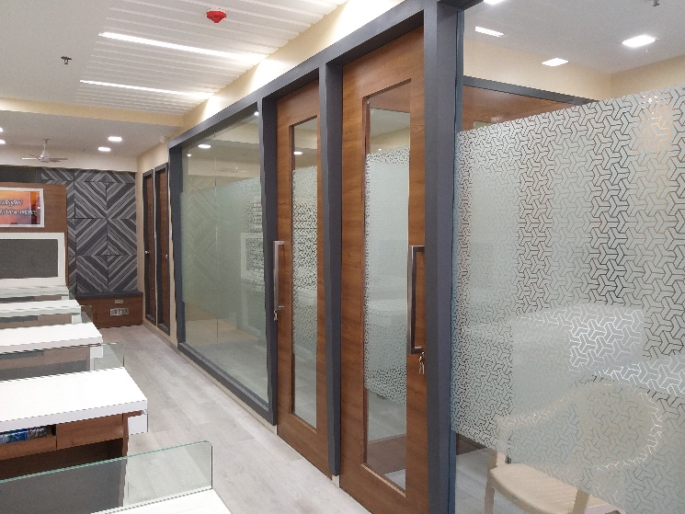
Our Portfolio – Turnkey solutions - Offices

Slide 9
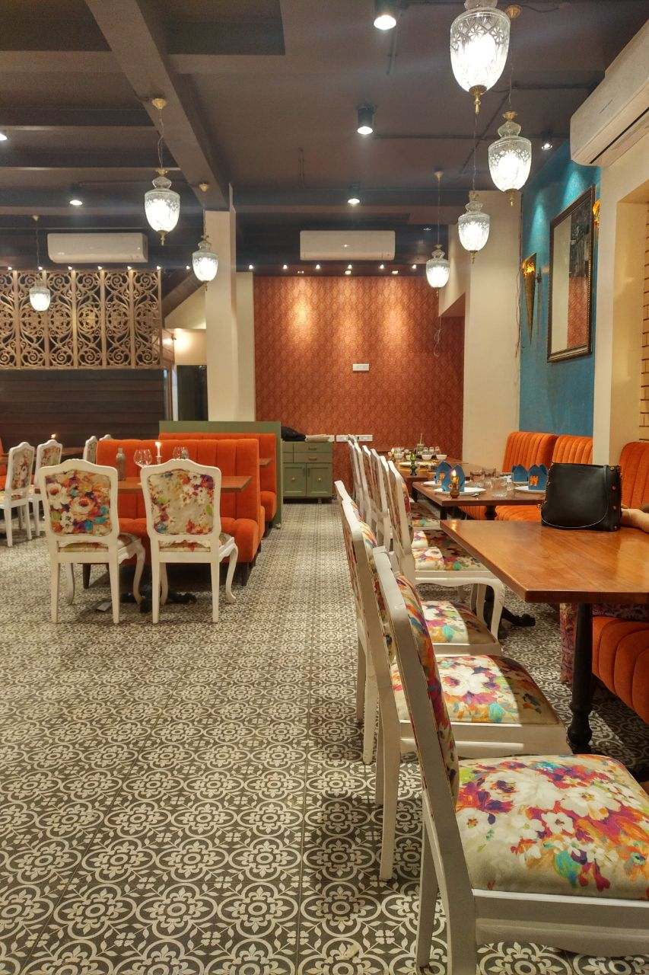
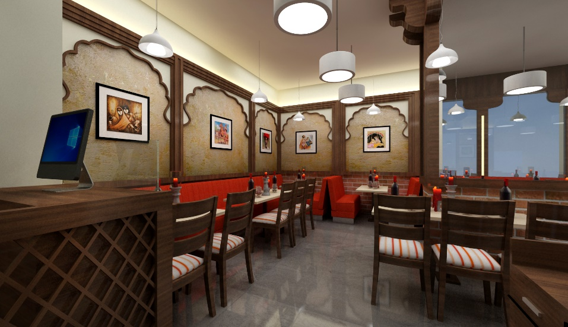
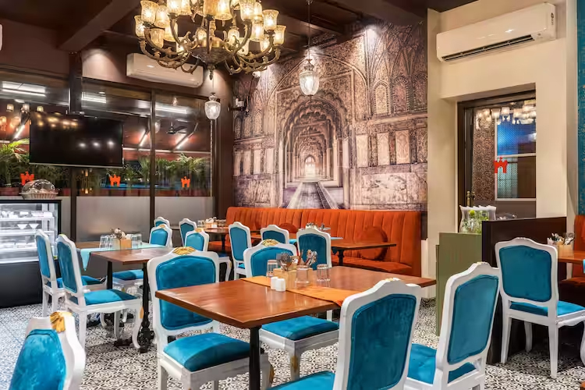
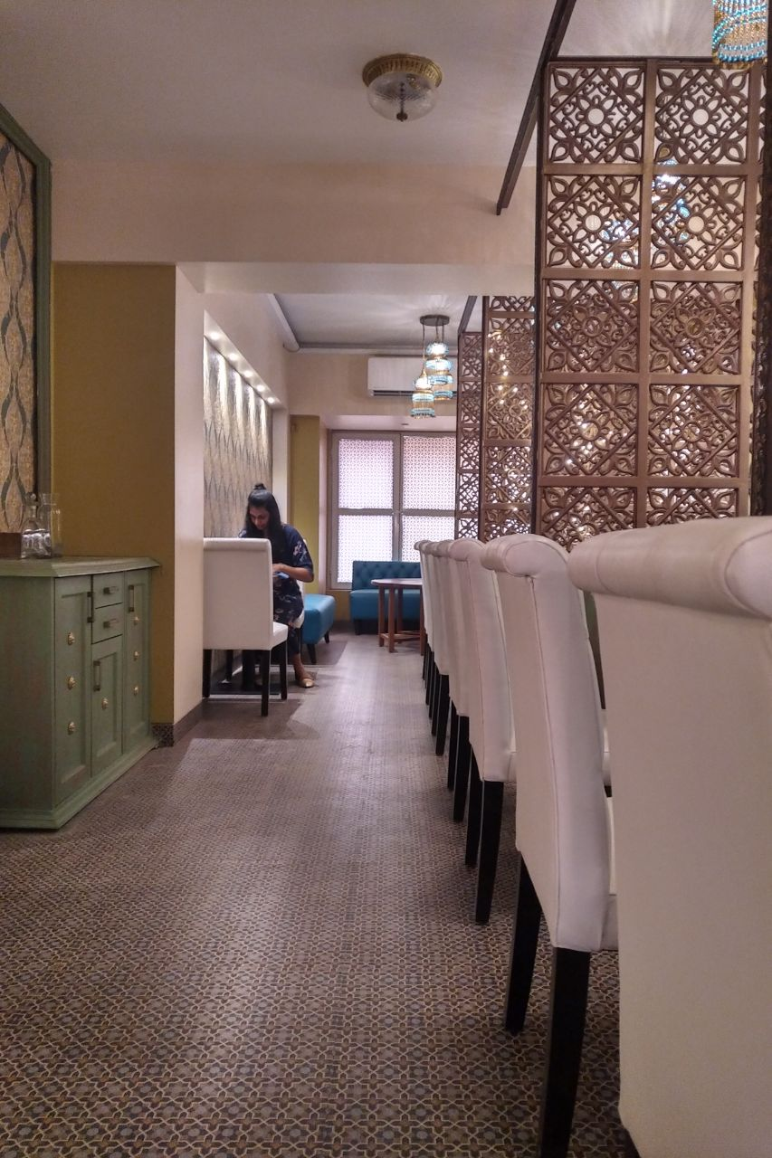
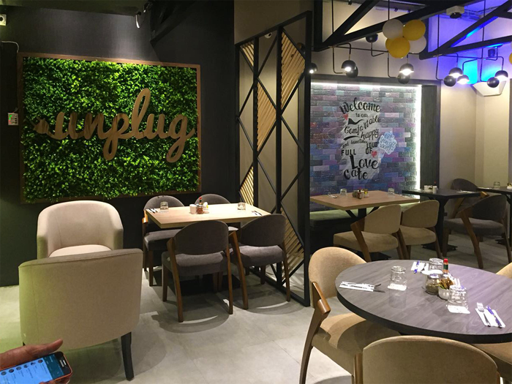
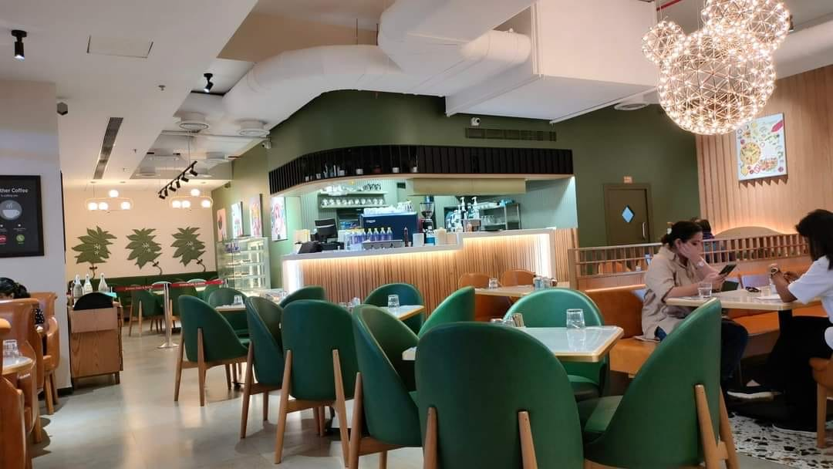
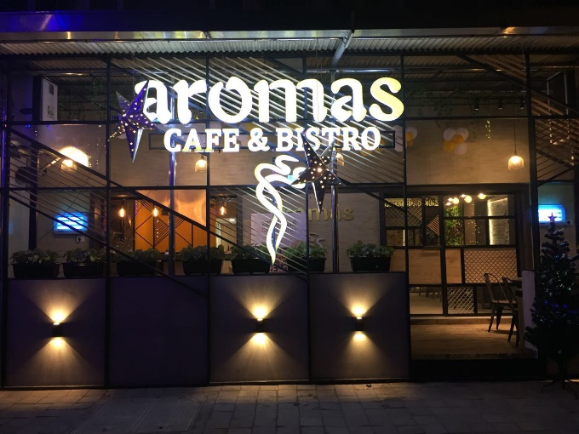
Our Portfolio–Turnkey solutions-Restaurants & Cafes

Slide 10
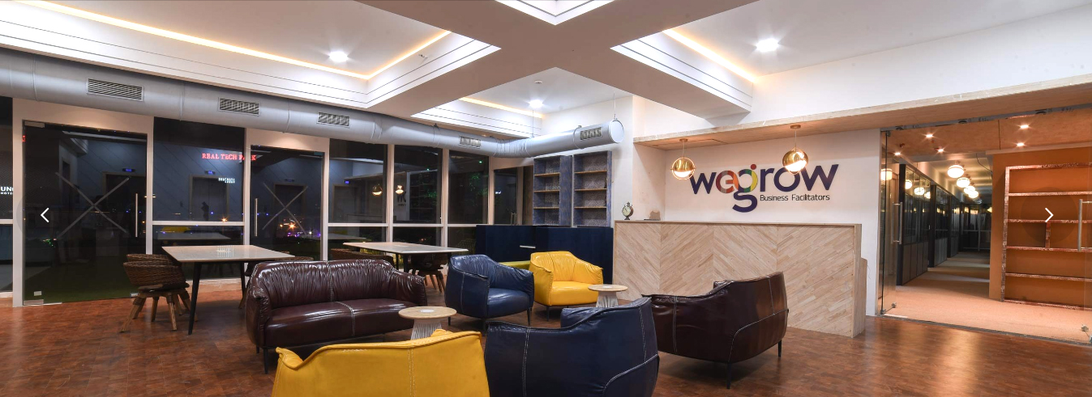
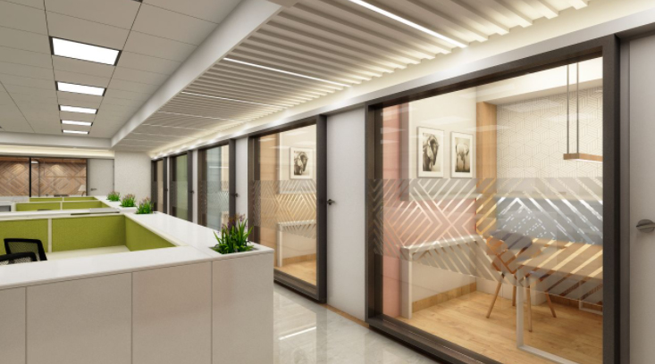
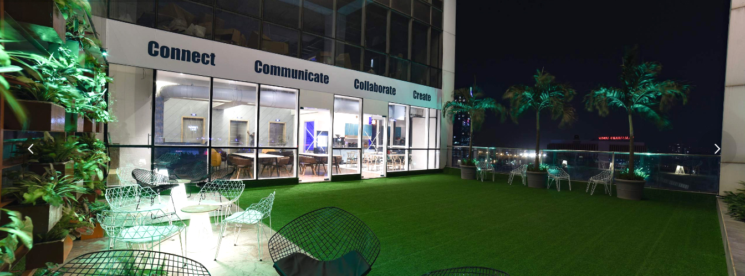
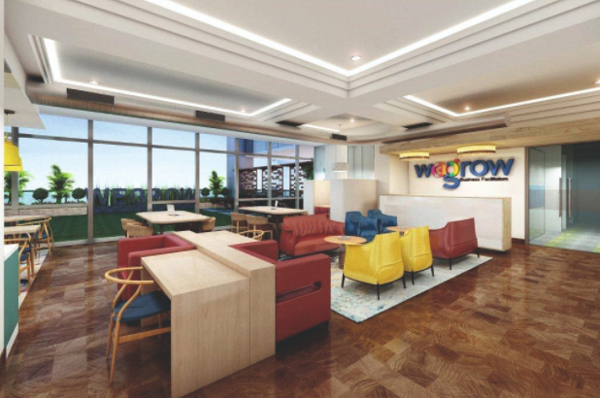
Our Portfolio – Co-working Space

Slide 11
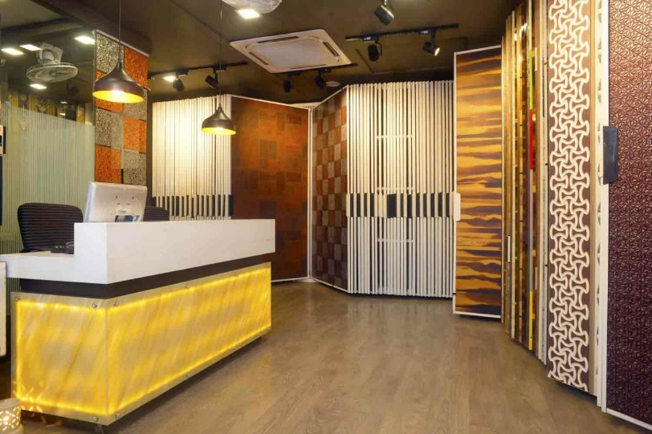
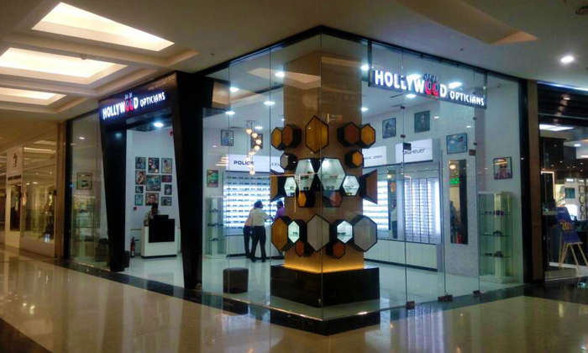
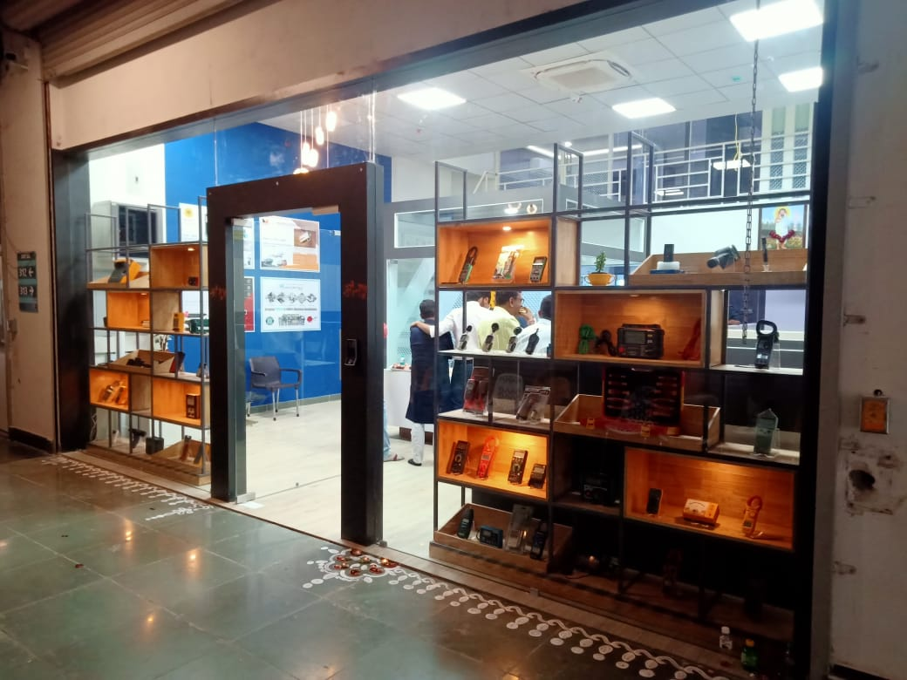
Turnkey solutions - Showrooms

Slide 12
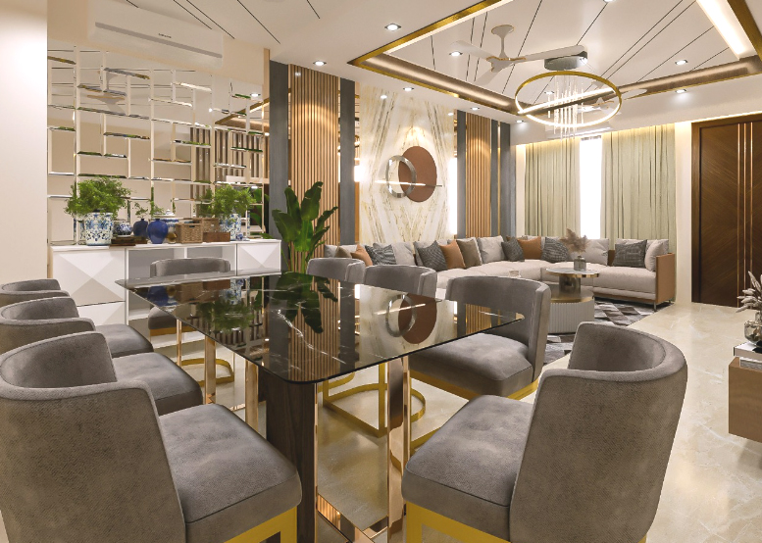
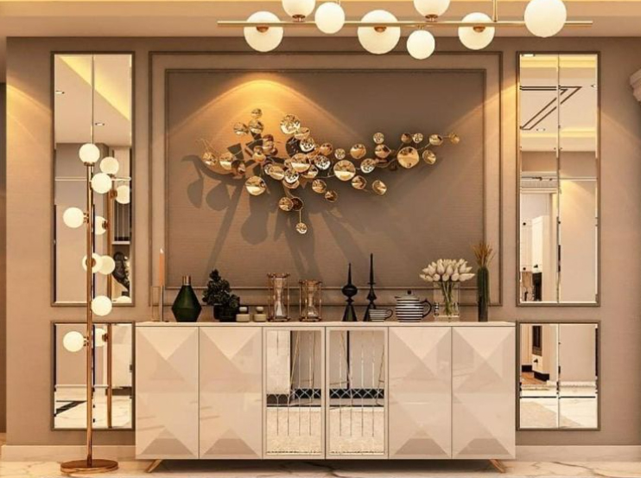
Turnkey solutions - Residences

Slide 13
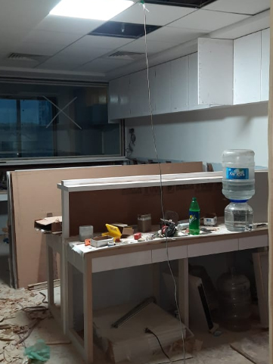
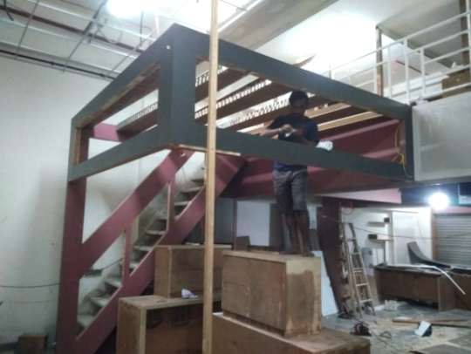
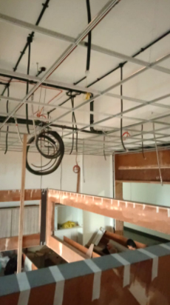
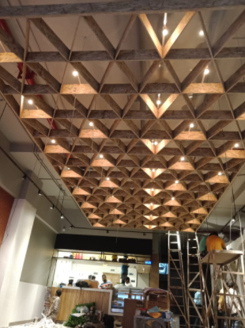
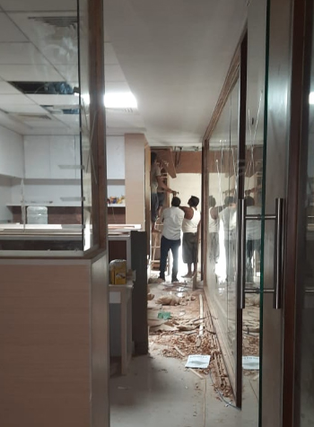
Work in Progress

Slide 14
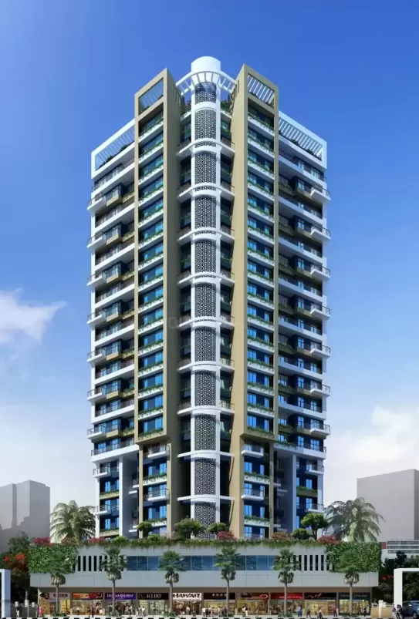



Consultancy solutions FOT SARA Realty
Sara Realities – Interiors of the show flat, sample flat and the entire facilities like Gym, terrace garden, café and Lobby

Slide 15




Turnkey solutions – Residences Dadar Mumbai
,

Slide 16



For Country House, Lodha Belmondo

Slide 17



For Siddh Vidya & Associates, Fort , Mumbai

Slide 18



For Shruti Agarwal, Navi Mumbai

Slide 19


For RS Design, Navi Mumbai

Slide 20


Why us
We provide the complete ecosystem you will need for your dream interiors /exteriors.
We carry out detailed planning and make sure all aspects have been adequately taken care.
We bounce theme based ideas with the client for clarity and general agreement.
We finish the project within the agreed timeline.
We are cost effective in the total cost of project.
We deliver what we promise.

Slide 21












Our Clients - Interiors

Slide 22














Our Clients - 3D Visualization

Slide 23

Thank you for your Attention
Email – spiregraphics@hotmail.com
www.spire-graphics.com
Phone : +91 8879571176

